Slide 1

Welcome
The Rotary Foundation –
PDG Bill Ferguson, DFC 2023-26

Slide 2
The Rotary Foundation
TITLE
Chesapeake PETS
PDG Bill Ferguson
March 3, 2023

Slide 3
The Mission of The Rotary Foundation
Notes:
The Mission of The Rotary Foundation is to enable Rotarians to advance world understanding, goodwill, and peace through the improvement of health, the support of education, and the alleviation of poverty.

Slide 4
The Mission of The Rotary Foundation is to enable Rotarians to advance world understanding, goodwill, and peace through the improvement of health, the support of education, and the alleviation of poverty.
Notes:
We started with a simple “DOING GOOD IN THE WORLD” Arch Klumph in 1917 and $2,600 dollars.

Slide 5
How TRUSTED is our Rotary Foundation?

Slide 6
Our Ratings by Independent Organizations
Charity Navigator: 4 Star Rating. 14 Years in a Row.
Guidestar: Platinum Member.
Number 56 on Forbes Top 100 Charities (ranked by size)

Slide 7
How Big is our Rotary Foundation?

Slide 8
Our Financial Resources.
Total assets of the Foundation of over 1.3 Billion Dollars
Katie Leisner, our Annual Giving Officer, Zones 33 can be contacted with questions
Laurie Menzel is our RF contact for Major Gifts, Endowment or Bequest Gifts

Slide 9
Our Financial Resources.

Slide 10
Our Financial Resources.

Slide 11
The Rotary Foundation has Seven Areas of Focus
Promoting Peace
Fighting Disease
Sanitation and Clean Water
Maternal and Child Health
Supporting Education
Growing Local Economies
Protecting the Environment

Slide 12
How to Use The Rotary Foundation

Slide 13
$1,000
Annual Fund
SHARE
Earnings help pay for
TRF
administration
YEAR 1
YEAR 2
YEAR 3
District Designated Fund (DDF)
S
World Fund
50% = $500
50% = $500
47.5% = $475
47.5% = $475
2.5% = $25
2.5% = $25
Share
For TRF administration

Slide 14
DISTRICT 7630
2020-2021
Annual Fund Contributions
$221,350 (est)
47.5 % to the World Fund $105,141
47.5 % to our District Designated Fund (DDF) $105,141

Slide 15
DISTRICT DESIGNATED FUND
Districts may allocate up to 50% of their DDF to District Grants.
50% for District Grants
$52,570.50
Our 2023-2024 District Designated Fund (DDF) $105,141
50% for Global Grants $52,570.50

Slide 16
DISTRICT GRANTS … Up to $5,000.00
Clubs apply to the district
$1,000 to $5,000 award
Clubs contribute at least 20% (your minimum project budget is $1,250)
Clubs incur all expenses upfront (YES!)
Grant award is paid after satisfactory completion of final report
Chair is Margaret Mudron.

Slide 17
DISTRICT GRANTS …up to $5,000.00
Grants Management Seminar
Minimum of two club members must attend
Both attendees must be part of the grant project committee, their names must appear on the application, and they must oversee the project through completion (final report)
Seminar is 10 am to Noon on March 25 via Zoom. Log in Detail is in the Weekly Reminders and at RotaryDistrict7630.Org

Slide 18
GLOBAL GRANTS … $ 52,570.50
Sustainable projects with measurable goals
Minimum $30,000 project budget
Two partner clubs, host and international
Requires community assessment
Aligns with one of Rotary’s 7 areas of focus
Actively involves Rotarians and community members

Slide 19
GLOBAL GRANTS … $52,570.50
Talk to PDG Bill or PDG Susan Giove, our Global Grant Chair, about your project budget and timing to confirm what DDF funds may be available and when.
Determine how much money you need to support a project
Fundraise and get commitments to fund 50% to 60% of your project. Determine your timeline so as to make your contribution to the Annual Fund.

Slide 20
GLOBAL GRANTS … $52,570.50
The district will try to match your contributed funds with DDF to fund the remaining portion of your grant.
The World Fund will match these DDF contributions at 80%,
For Example, DDF of $20,000 is awarded to a project. The World Fund will match with $16,000 for a total project of $36,000.
Cash donations are no longer matched by the World Fund and any cash donations incur a 5% expense fee.

Slide 21
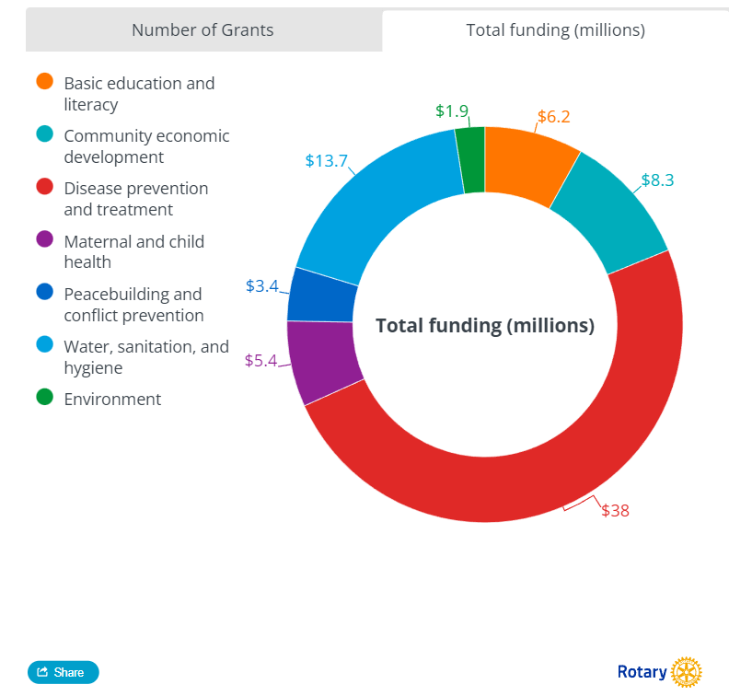
GLOBAL GRANTS … $52,570.50

Slide 22
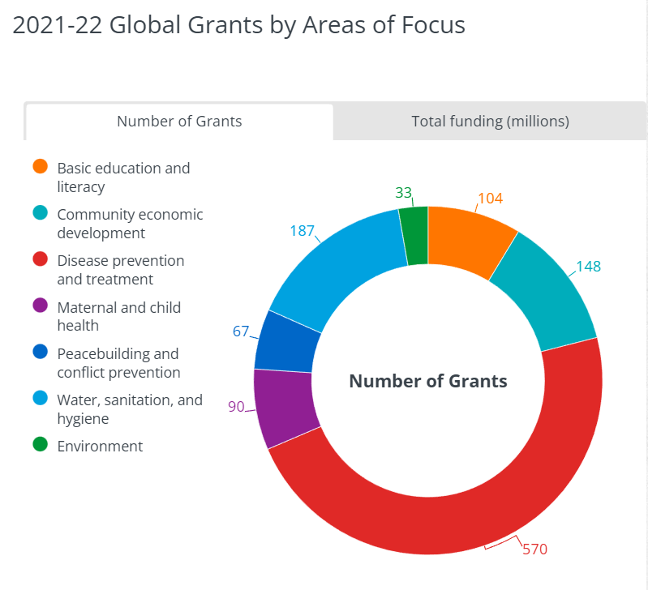
GLOBAL GRANTS … $52,570.50

Slide 23
FOUNDATION POINTS
Foundation recognition points are awarded to donors who contribute to the Annual Fund or PolioPlus
  One point for each dollar
Donors can transfer Foundation points to help them qualify as a Paul Harris Fellow or Multiple Paul Harris Fellow

Slide 24
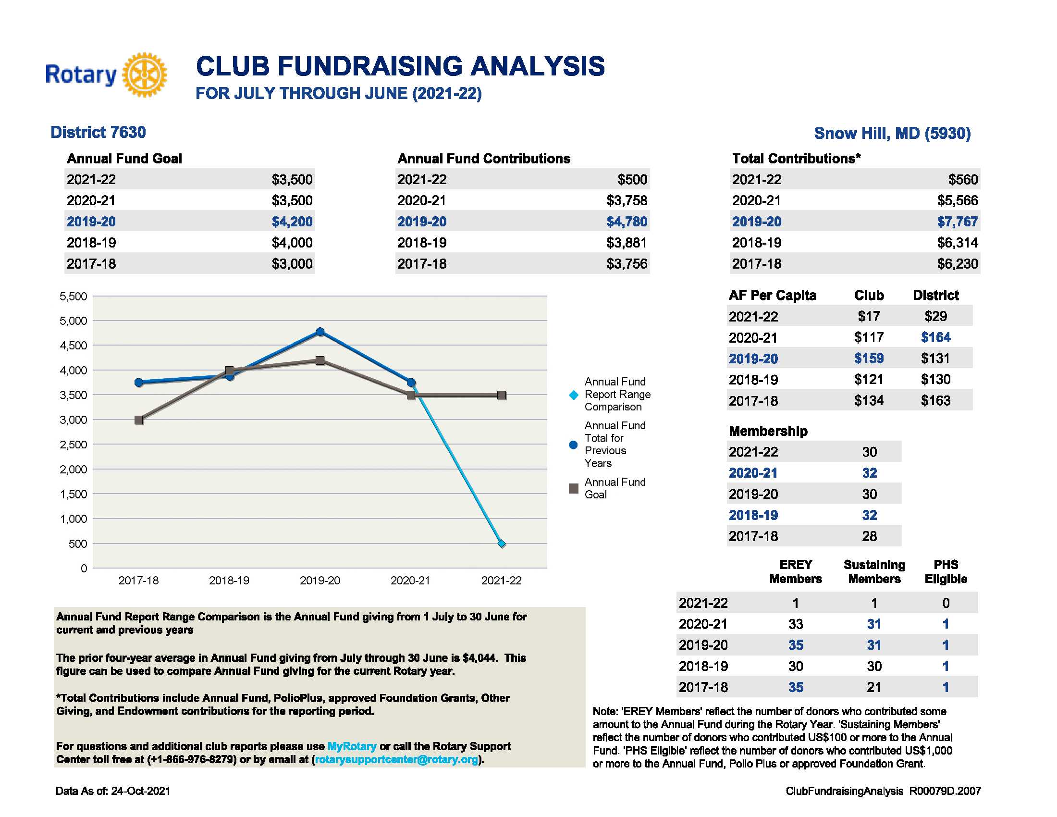
Snow Hill Rotary Club Foundation Report

Slide 25
How Can You Contribute?
New suggested Rule of 85! Still $85 per month but distributed $75 to annual fund and $10 to Polio Plus.
Every Rotarian, Every Year: $100 per year.
More ways than that, if you would like to make a Major Gift, you can contact Laurie Menzel, our Rotary Foundation Major Gifts Officer or contact Cathy Parsons, Major Gifts Chair!

Slide 26
Contributing to the Rotary Foundation
Forms to make Donations in your packet
Individual Contribution Form
Points Transfer Form
Club Fundraising Analysis
Club Recognition Summary for each PE’s club
District Monthly Contribution Report for program years 24 & 25
Endowment Fund Update

Slide 27
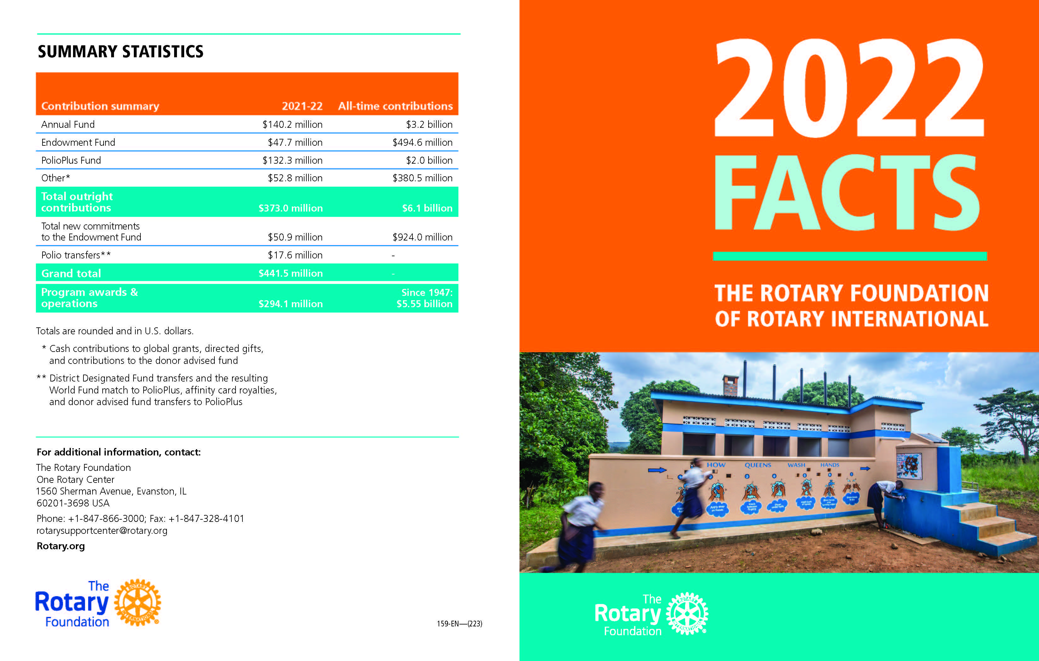

Slide 28
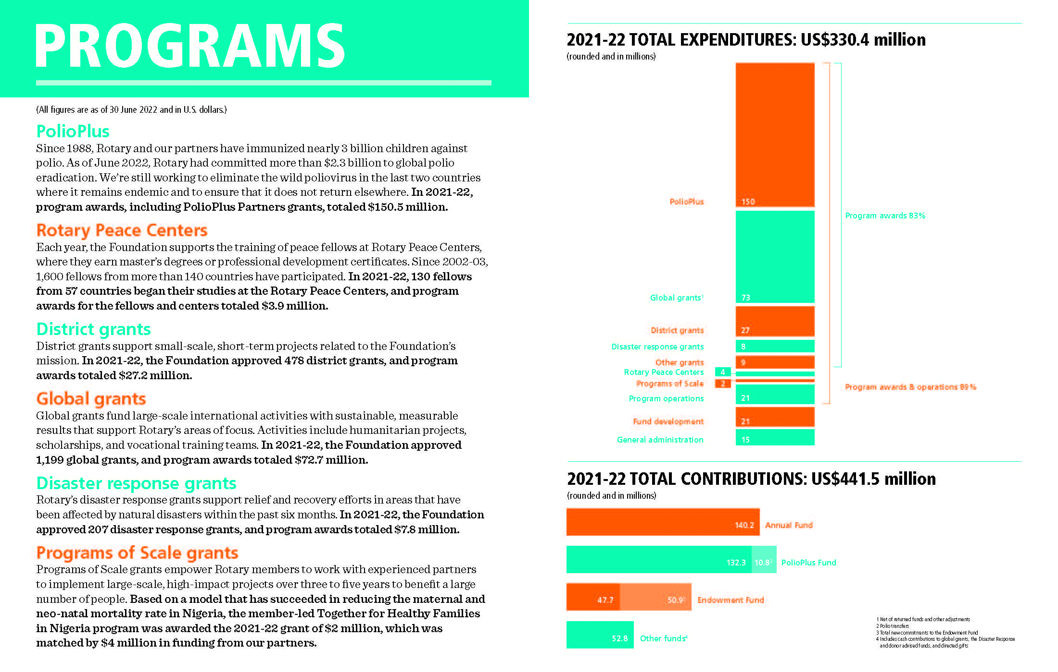

Slide 29


Polio MIlestones
20 Million people either walking or alive because of Rotary and its world partners.
5 of 6 World Health regions are certified polio-free
Africa certified Polio-Free-August 2020
2022 - 30 cases of Wild Polio
2-Afghanistan, 20-Pakistan, 8-Mozambique
2023 - ZERO cases of Wild Polio
Rotary & its world partners vaccinated more than 600 MILLION kids in developing countries in 2022.

Slide 30
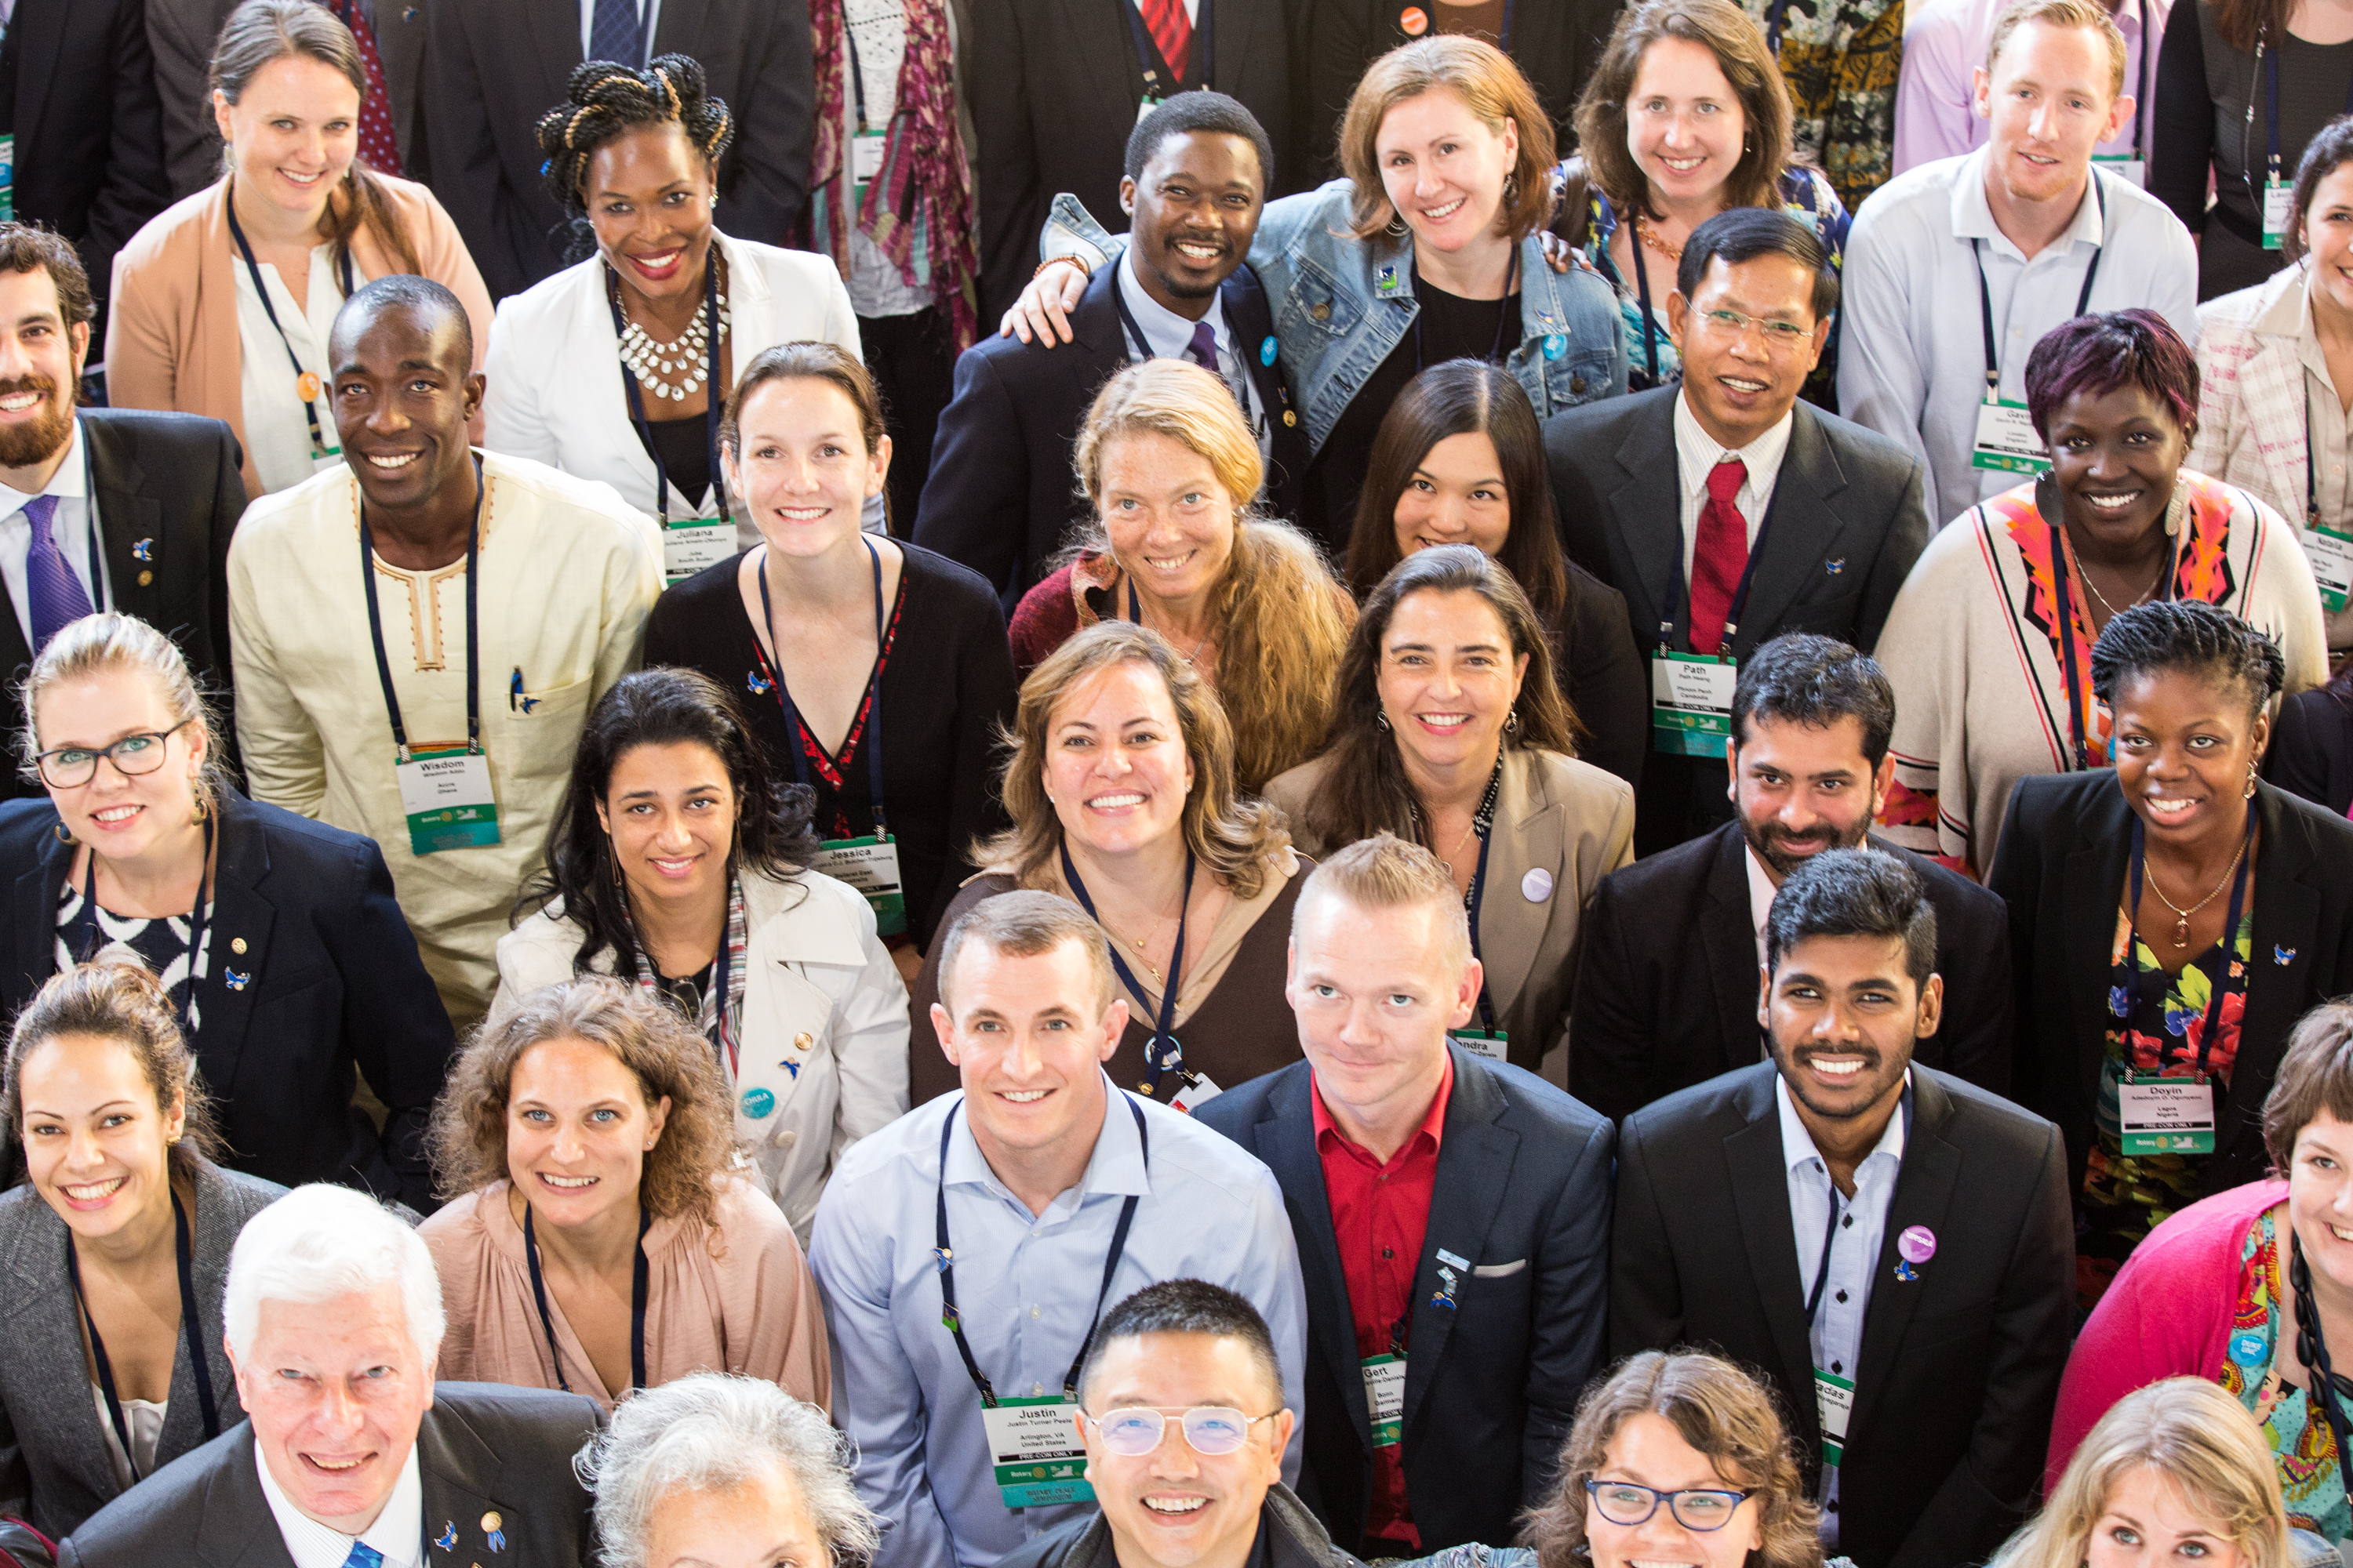
Rotary Peace Centers - Fellowships
The Rotary Peace Centers program has a vision of sustainable peace:
encompassing a network of peacebuilders and community leaders dedicated to preventing and resolving conflicts across the global community
Notes:
The Rotary Peace Centers program was established in 2002 with a vision of creating sustainable peace, by building networks of peace builders and community leaders dedicated to preventing and resolving global conflicts.

Slide 31
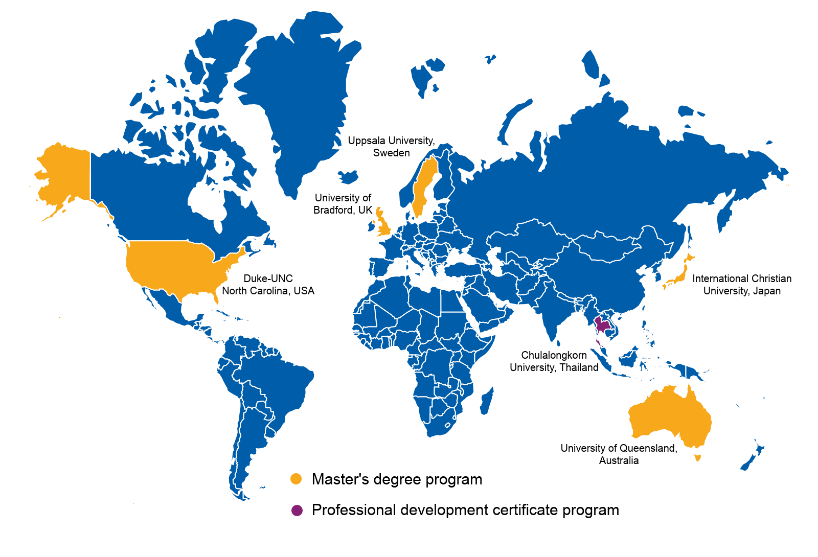
Rotary Peace Centers University Partners
Notes:
Currently there are 6 Rotary Peace Centers at seven universities. Five of which offer master level degrees in a range of disciplines related to peace and security:
In the US, there is a joint program at Duke University and the University of North Carolina-Chapel Hill.
The other centers are located at:
University of Bradford, England,
Uppsala University in Sweden
International Christian University in Japan
The University of Queensland in Australia
There is also a center at Chulalongkorn University in Thailand which hosts our 3 month certificate in peace and conflict studies.

Slide 32
QUESTIONS?
PDG Bill Ferguson, DRFC
443-786-6345
fergy123@comcast.net

Slide 33


Slide 34


Discussion

